Slide 1
Data Analysis and Visualization Mini-Symposium: VTK-m ECP Annual Meeting, February 2018
Kenneth Moreland Sandia National Laboratories
with contributions from Hank Childs, David Pugmire, and the rest of the VTK-m team
February 8, 2018
Sandia National Laboratories is a multi-mission laboratory managed and operated by National Technology and Engineering Solutions of Sandia, LLC., a wholly owned subsidiary of Honeywell International, Inc., for the U.S. Department of Energy’s National Nuclear Security Administration under contract DE-NA0003525. SAND NO. 2018-0478 PE

Slide 2
Acknowledgements
Sandia National Laboratories is a multimission laboratory managed and operated by National Technology and Engineering Solutions of Sandia LLC, a wholly owned subsidiary of Honeywell International Inc. for the U.S. Department of Energy’s National Nuclear Security Administration under contract DE-NA0003525.
This research was supported by the Exascale Computing Project (17-SC-20-SC), a joint project of the U.S. Department of Energy’s Office of Science and National Nuclear Security Administration, responsible for delivering a capable exascale ecosystem, including software, applications, and hardware technology, to support the nation’s exascale computing imperative.

Slide 3
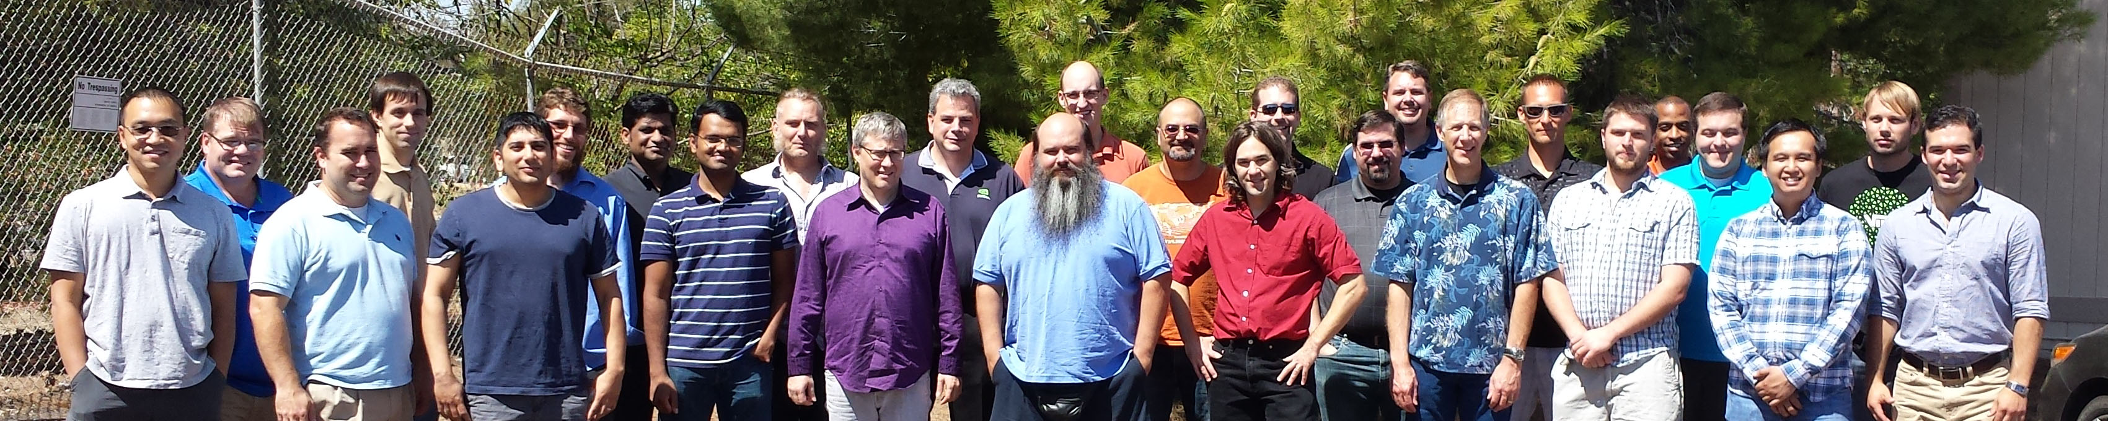
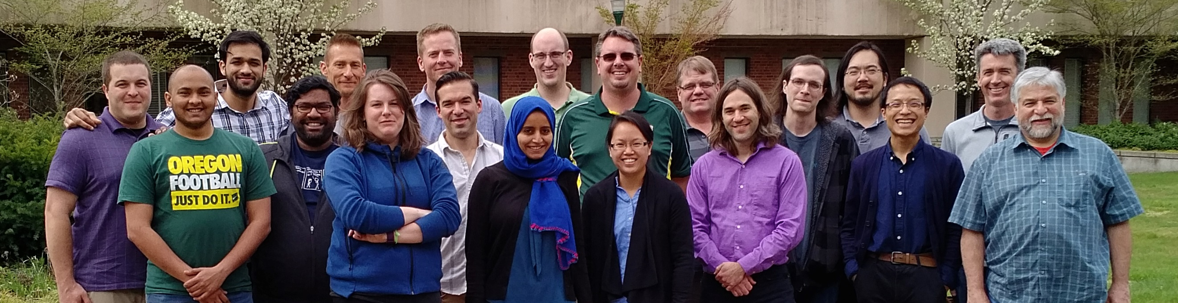
Thanks to All Our Partners!
Code Sprint, September 2015, LLNL
Code Sprint, April 2017, University of Oregon

Slide 4
Why VTK-m?

Slide 5
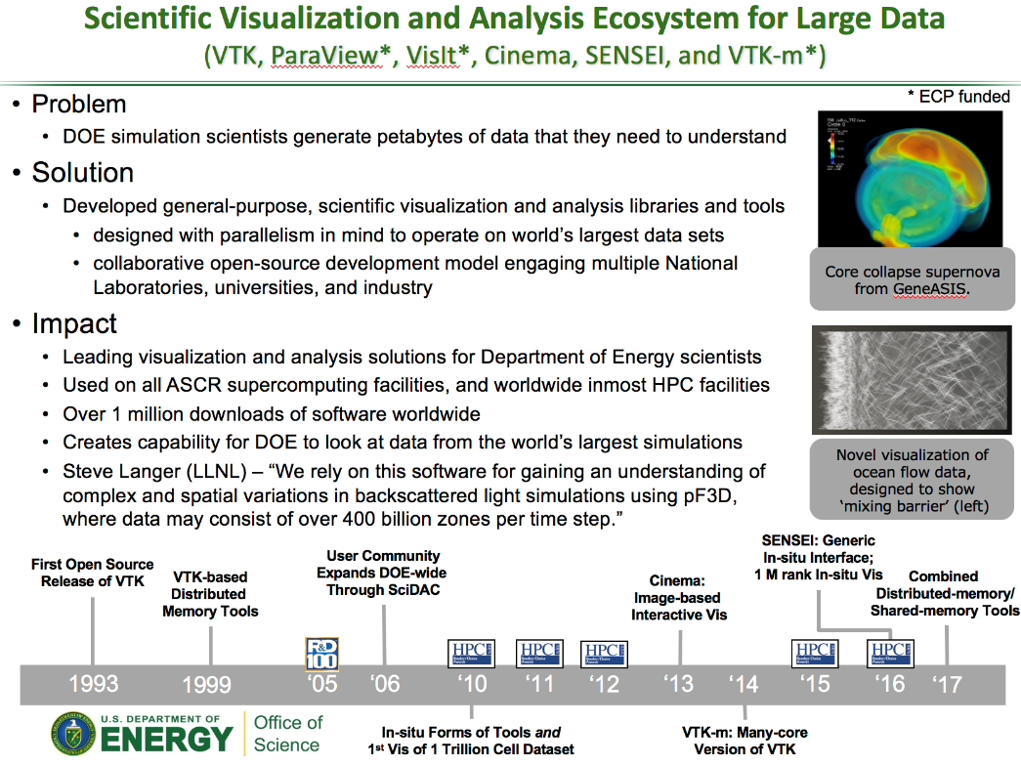
Visualization and Analysis for HPC: Current Status
Developed popular, open source tools (ParaView, VisIt) based on the Visualization ToolKit library (VTK)
Widespread usage in DOE and >1 million downloads worldwide
Hundreds of person years of effort
Two major problems for exascale:
Many-core architectures (as current VTK-based investments are primarily only MPI parallelism)
I/O limitations will require in situ processing
ASCR highlight slide for VTK-based tools.
ECP/VTK-m project focused on problem #1.
ECP ALPINE is focused on problem #2.
Our approaches are complementary and coordinated.

Slide 6
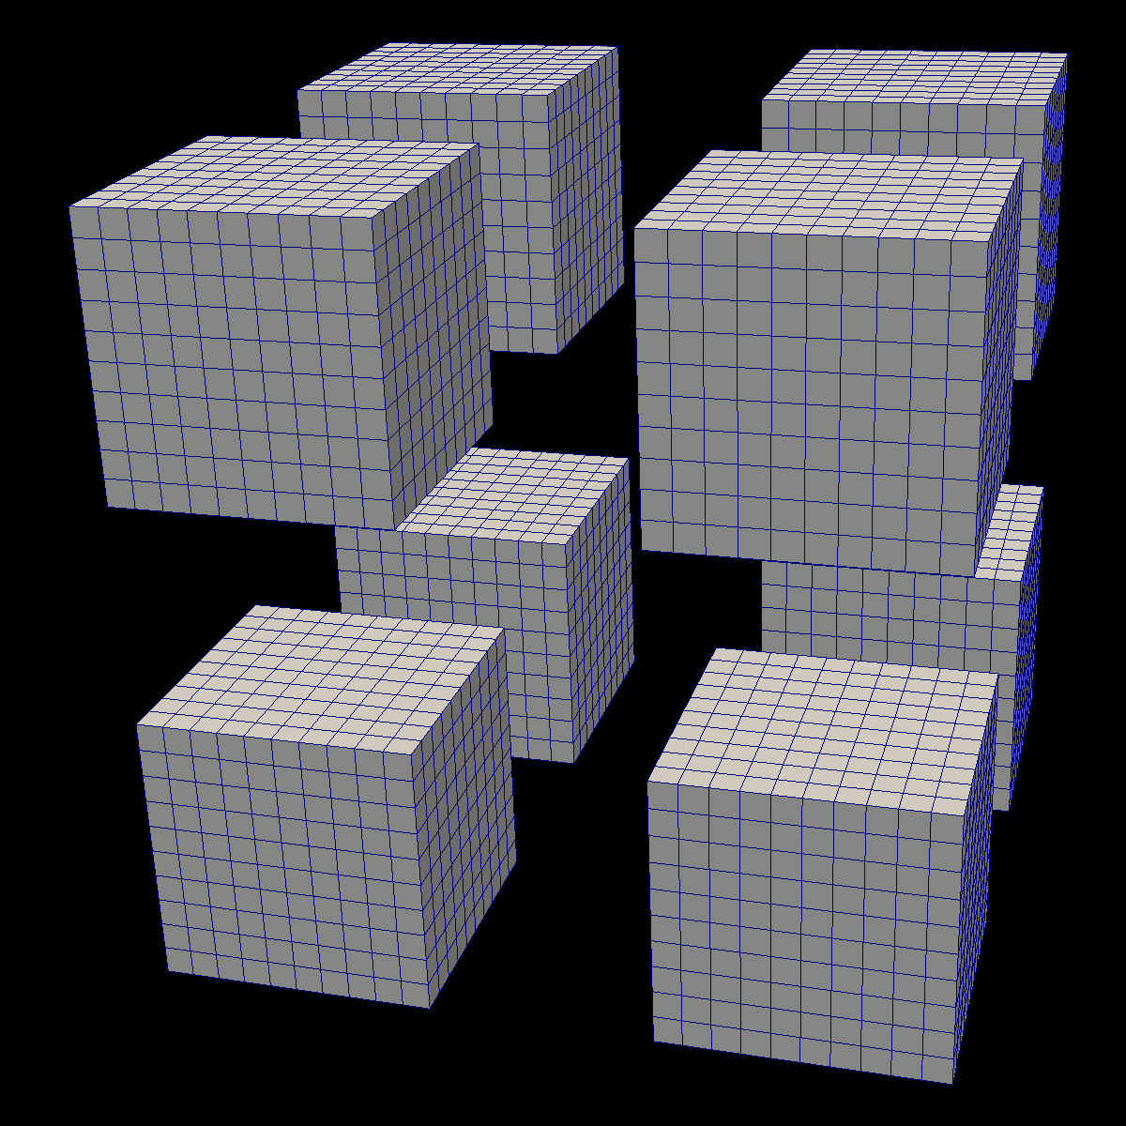
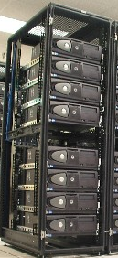


Distributed
Parallelism
ALPINE/ASCENT
On Node
Parallelism

Slide 7
VTK-m: the ’m’ is for many-core
VTK:
popular, open source, supported by a community
… but primarily single core only.
VTK-m:
name chosen to evoke the positive attributes of VTK
… but will support multi-core and many-core.
VTK-m is the only DOE effort for many-core visualization.
Previously there were 3 predecessor projects, but the PI’s of those projects decided to join forces in 2014 to make VTK-m.

Slide 8
VTK-m’s Role in ECP

Slide 9
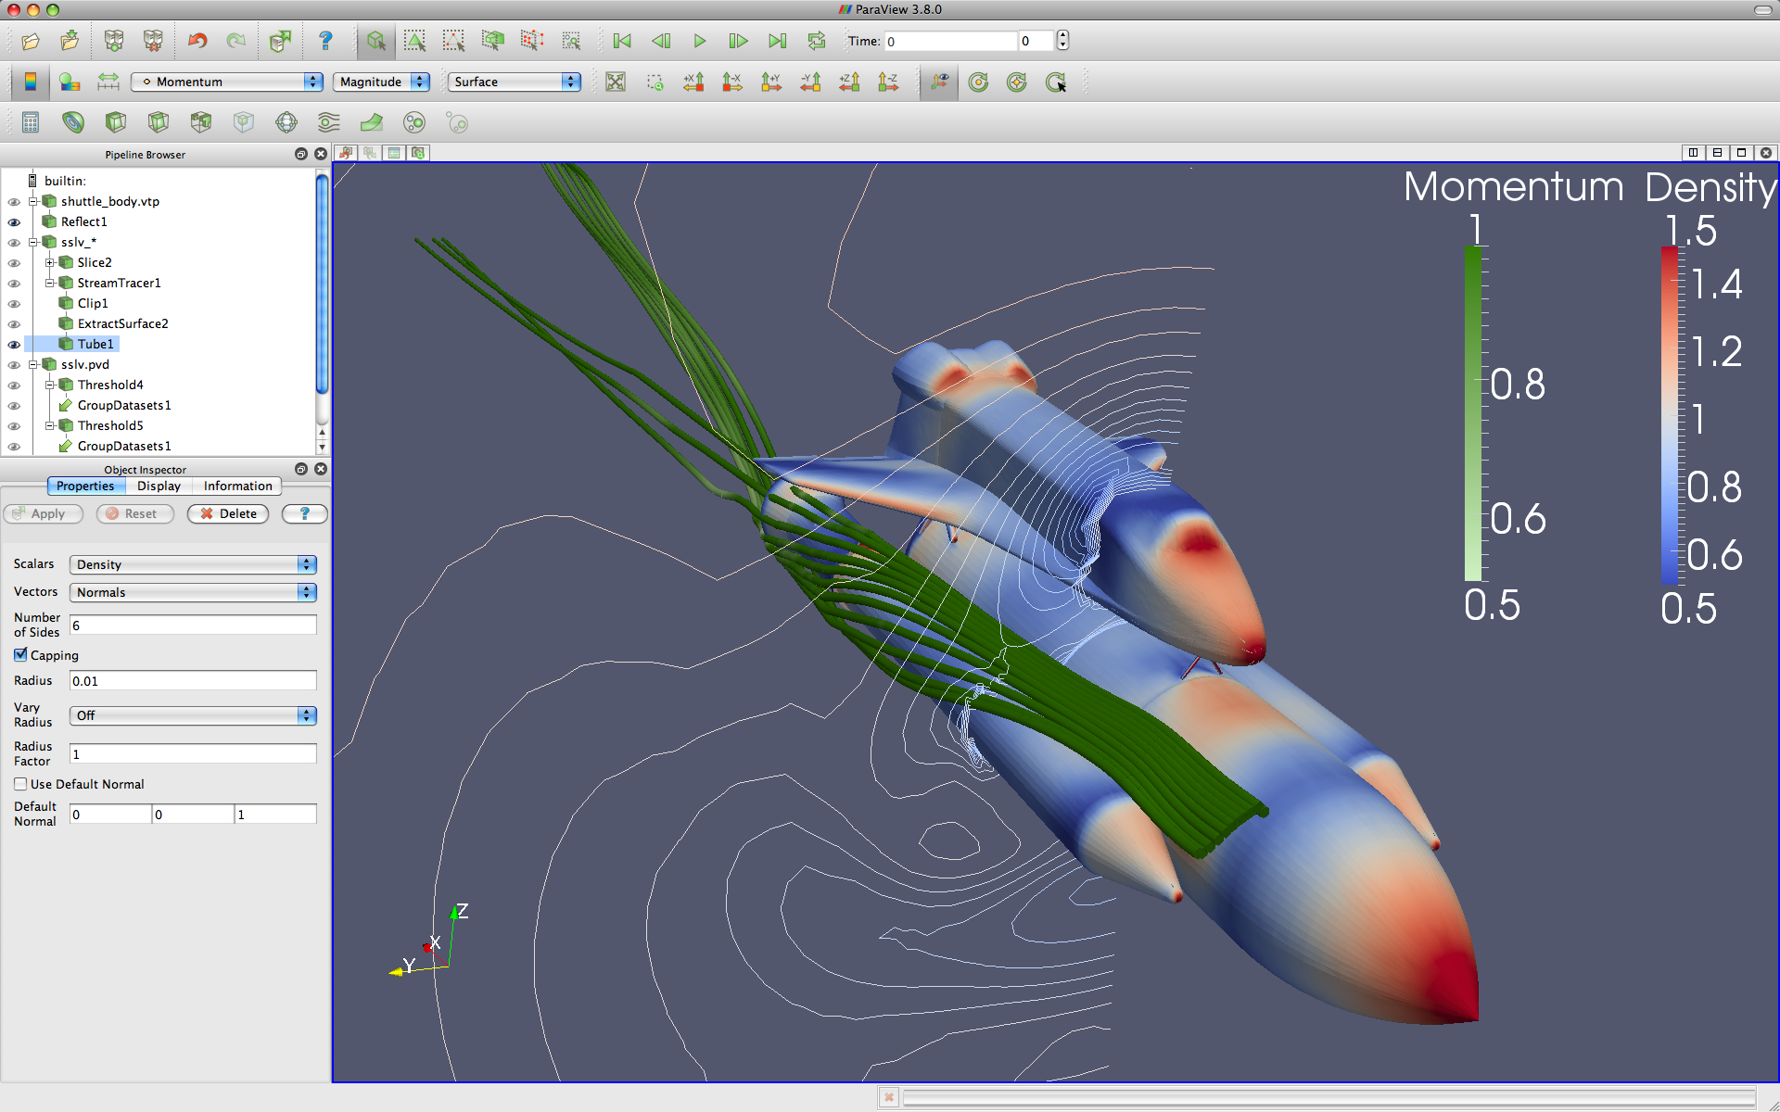



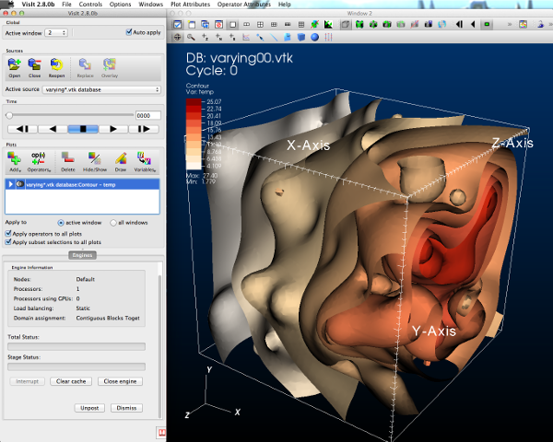
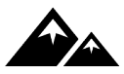


GUI / Parallel Management
In Situ Vis Library
(Integration with Sim)
Simulations
Base Vis Library
(Algorithm Implementation)
Libsim
ASCENT
Multithreaded Algorithms
Processor Portability

Slide 10
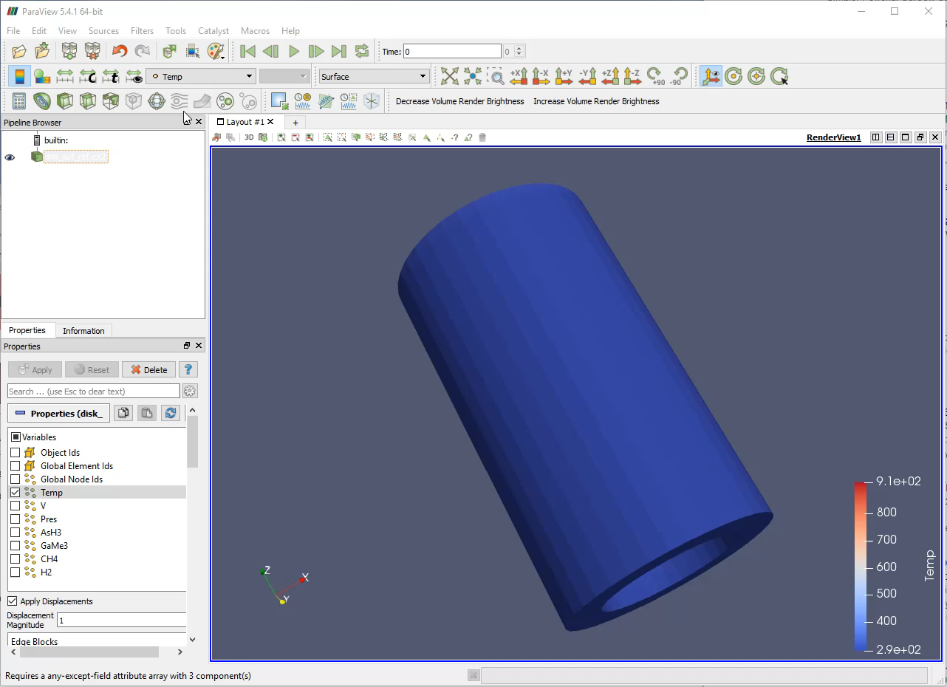

Slide 11
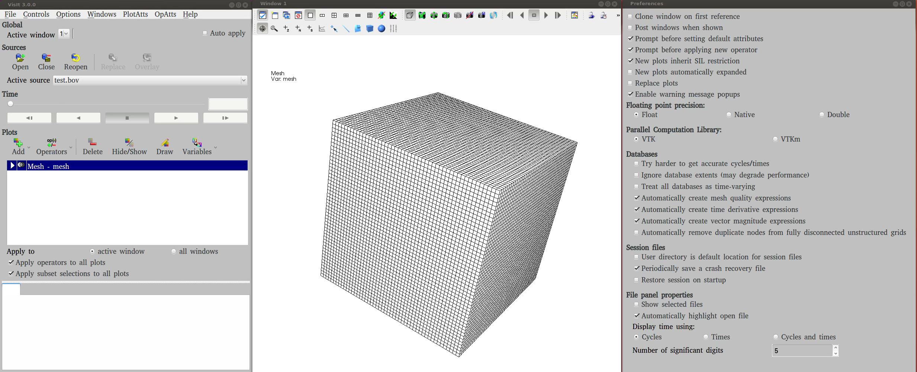

Slide 12
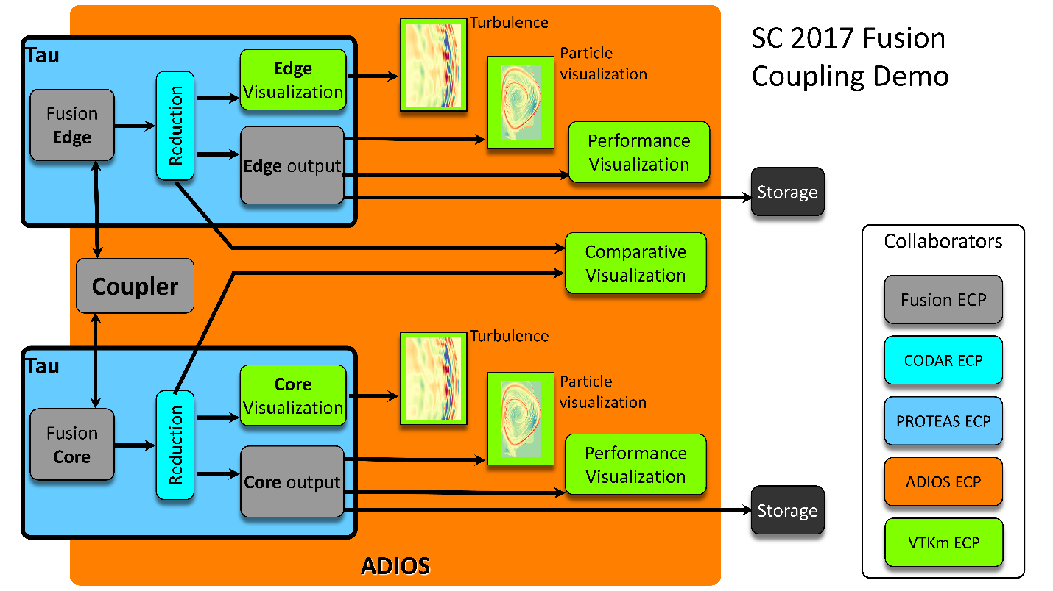
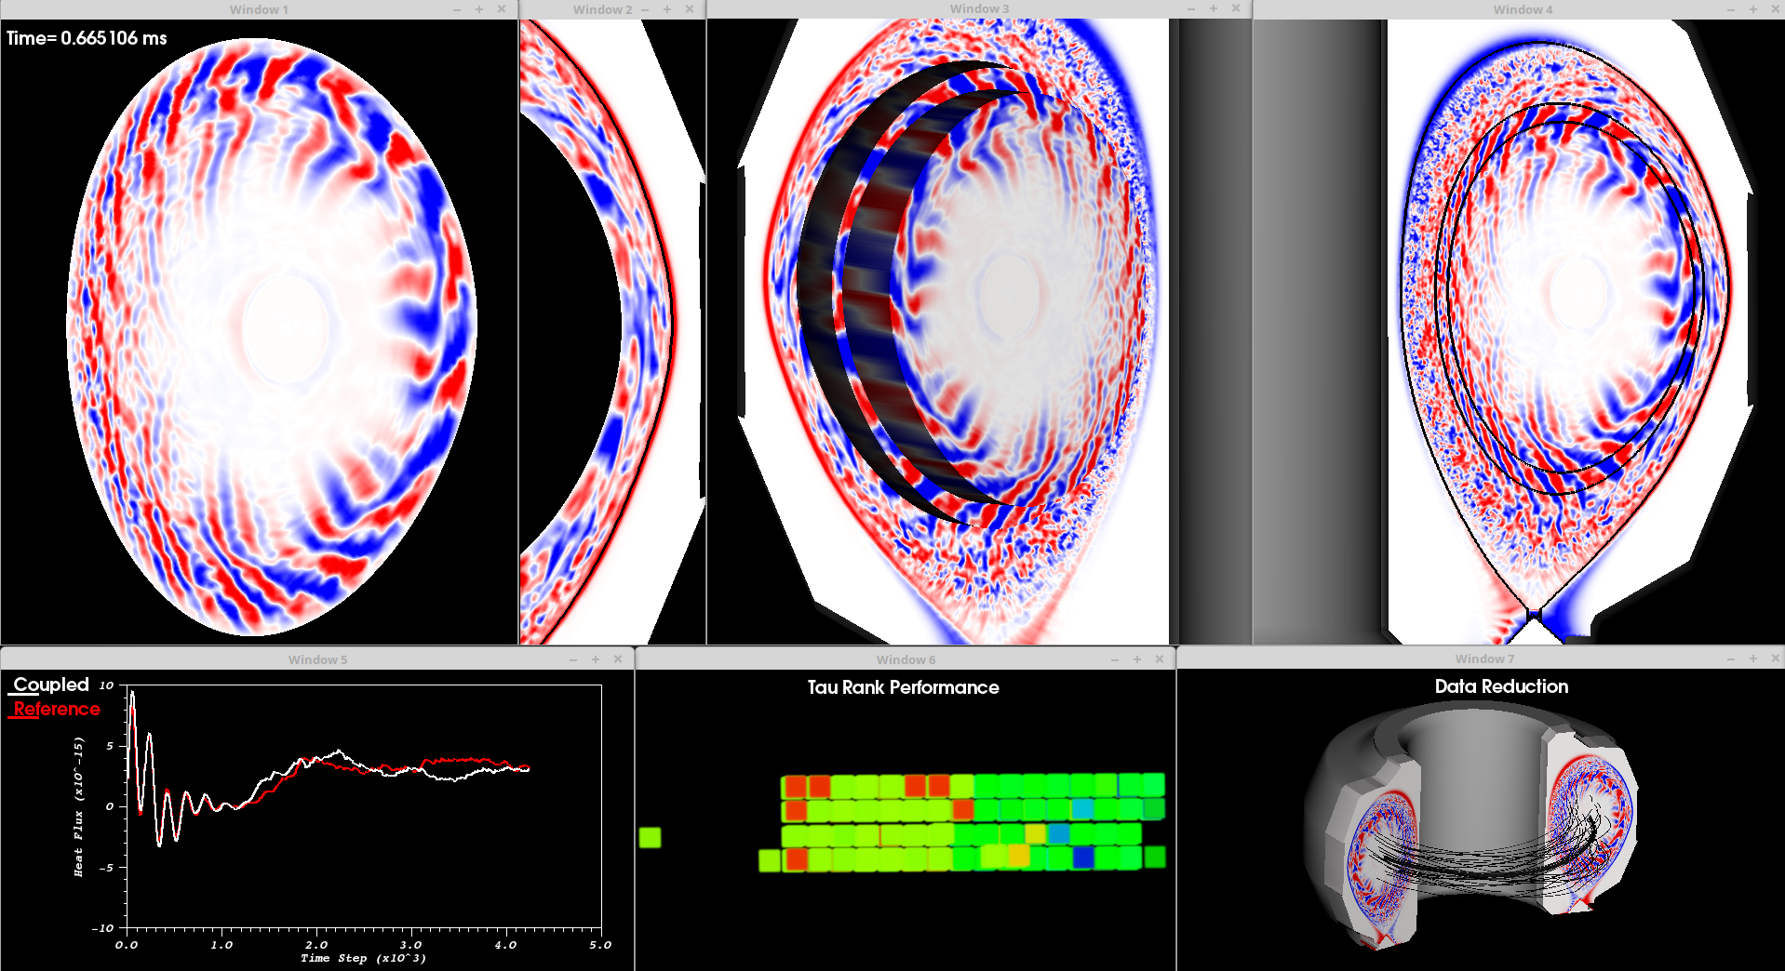
ECP SC17 Showcase: WBS 2.2.2.05 WDMApp, WBS 2.2.6.03 CODAR
Also starting work with NWChemEx (WBS 2.2.1.02). Scientific driver is the simulation of trans-membrane proteins. Workflow to run critical analysis, feature detection, and performance monitoring in situ. Partners include CODAR, ADIOS, and PROTEAS.
Notes:
Includes particle binning

Slide 13
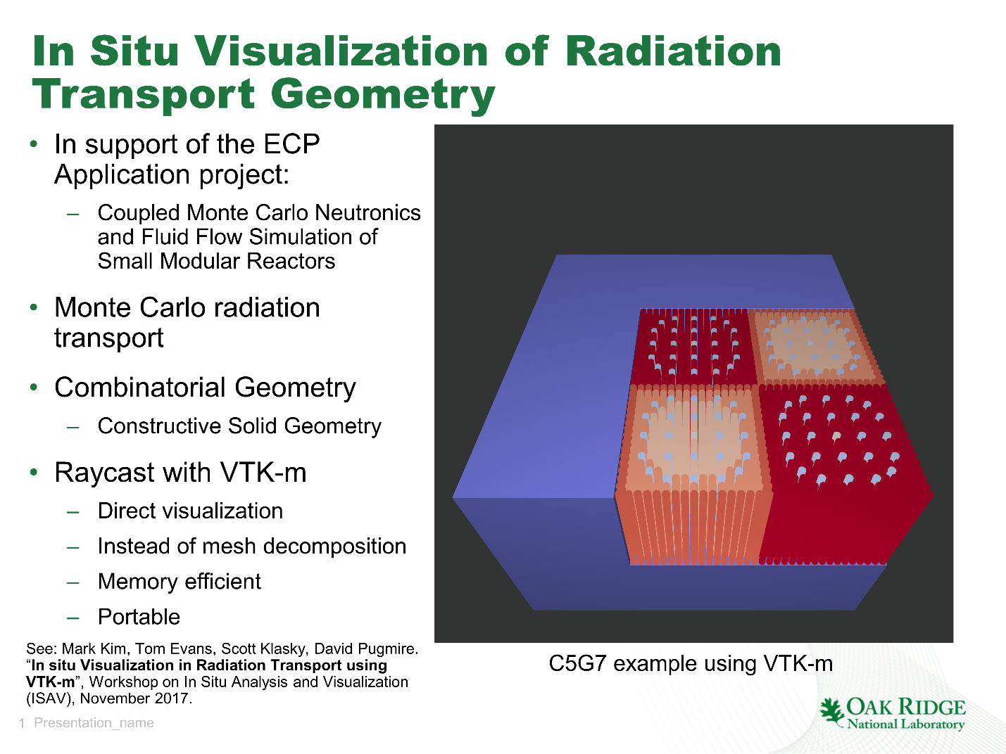
WBS 2.2.2.03 ExaSMR

Slide 14
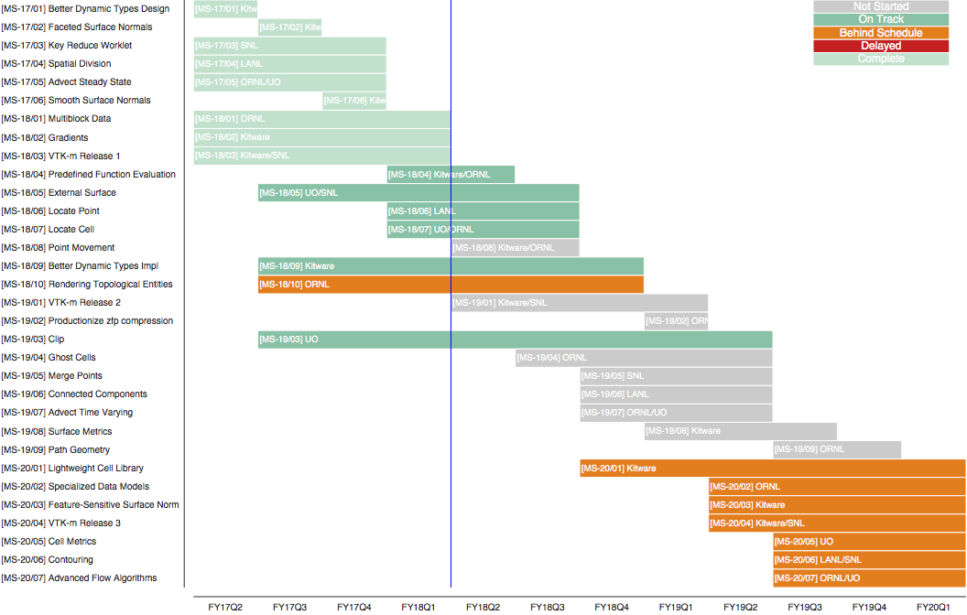

Slide 15
Conclusion
Let us know what further help you would like
Let us know how to prioritize our development
Is there something in particular you do a lot with ParaView, VisIt, Catalyst, Libsim, ASCENT, etc.?
Is there something that seems to be running slower in ParaView, VisIt, Catalyst, Libsim, ASCENT, etc.?
Is there functionality missing from ParaView, VisIt, Catalyst, Libsim, ASCENT, etc.?

